Slide 1
Improving Diagnostic Accuracy Through Data Mining
Harshini Naidu Ganapathy
CSCI 6443 Data Mining Term Paper

Slide 2
Abstract
There is a critical global health issue: misdiagnosis. Each year, incorrect diagnoses affect millions of individuals.
The professional lives of physicians are at risk due to unintended errors in medication prescription.
Paper focuses on leveraging data mining techniques to analyze a dataset of medical prescriptions.
The objective is to unearth patterns and knowledge that can enhance the diagnostic process, ultimately aiming to support patient health, reduce unnecessary financial expenditure, and assist physicians in making accurate diagnoses.
The project is aiming to predict drug classifications based on prescription data.

Slide 3
Table of Contents
1. Introduction
2. Objectives of Study
3.Literature Survey
4.Methodology Overview
5.Dataset
6. Ensemble Learning Models
7.Stacking
8. Data Preprocessing
6. Model Training and Evaluation
9. Results
10. Applications
11. Conclusion

Slide 4
Introduction and Motivation
Research indicates that annually, around 12 million people globally are impacted by incorrect medical diagnoses, translating to about 5% (or one in 20) of patients receiving the wrong diagnosis.It's estimated that misdiagnosis leads to the deaths of 40,000 to 80,000 individuals each year.
One third of medical mistakes leading to death or disability stem from incorrect or delayed diagnoses.Disease diagnosis involves identifying the illness that most accurately corresponds to an individual's symptoms.
Numerous researchers have developed a variety of machine learning algorithms aimed at accurately recognizing a broad spectrum of illnesses. These algorithms can construct models that predict which drug class they fall into and suggest appropriate treatments.
The abundance of data accessible has made disease prediction a critical area of study. Researchers utilize these extensive datasets to develop models for disease prediction within decision-making systems, facilitating enhanced early-stage disease detection and treatment.

Slide 5
Objectives of the Study
01
The paper focuses on leveraging data mining techniques to analyze a dataset of medical prescriptions. The objective is to identify patterns and insights that can help improve the diagnostic process, making it more accurate and reliable.
02
By improving diagnostic accuracy, it can benefit patient health by reducing misdiagnoses, which often lead to inappropriate treatments. Furthermore, enhanced diagnostic accuracy can alleviate the financial burdens imposed on patients, insurance companies, and healthcare systems due to incorrect treatments and unnecessary procedures.
03
Another key objective is to provide physicians with data-driven insights and tools derived from the analyzed prescription data. This support will help doctors make more accurate diagnoses, ultimately safeguarding their professional integrity and improving patient outcomes through better decision-making processes.

Slide 6
Literature Survey: Overview
In the current era, the importance of early diagnosis cannot be overstated. In 2021 a team employed machine learning techniques to predict diseases based on symptomatic data. Their findings highlighted that the Convolutional Neural Network (CNN) algorithm outperformed the K-Nearest Neighbors (KNN) algorithm in predicting general diseases, with a reliability rate of 84.5%.
An algorithm for selecting features designed to improve the efficacy of machine learning techniques, termed the Information Gain-based Feature Selection (IGFS). Their research demonstrated that, when applied, the Support Vector Machine (SVM) and Random Forest (RF) algorithms exhibited the best results, achieving an accuracy rate of 88%.
A study is conducted to forecast the kind of physician—whether public or private—a patient was referred to, as well as the specific disease they were diagnosed with. The dataset utilized in this research comprised 70 distinct disease types, 386 different drugs, and encompassed a total of 600 patient records. To enhance the predictive capability of their model, a stacking approach was employed.

Slide 7
Methodology Overview
DATA COLLECTION
Dataset is taken from Data.CMS.gov site.
I used the dataset Medicare Part D Prescribers by Geography and Drug.
It has 114891 rows of data.
ALGORITHM
Ensemble Learning Model
Base Learner - Random Forest, Gradient Boosting, K-Nearest Neighbors, and Decision Tree.
Meta Learner - Naive Bayes classifier.

Slide 8
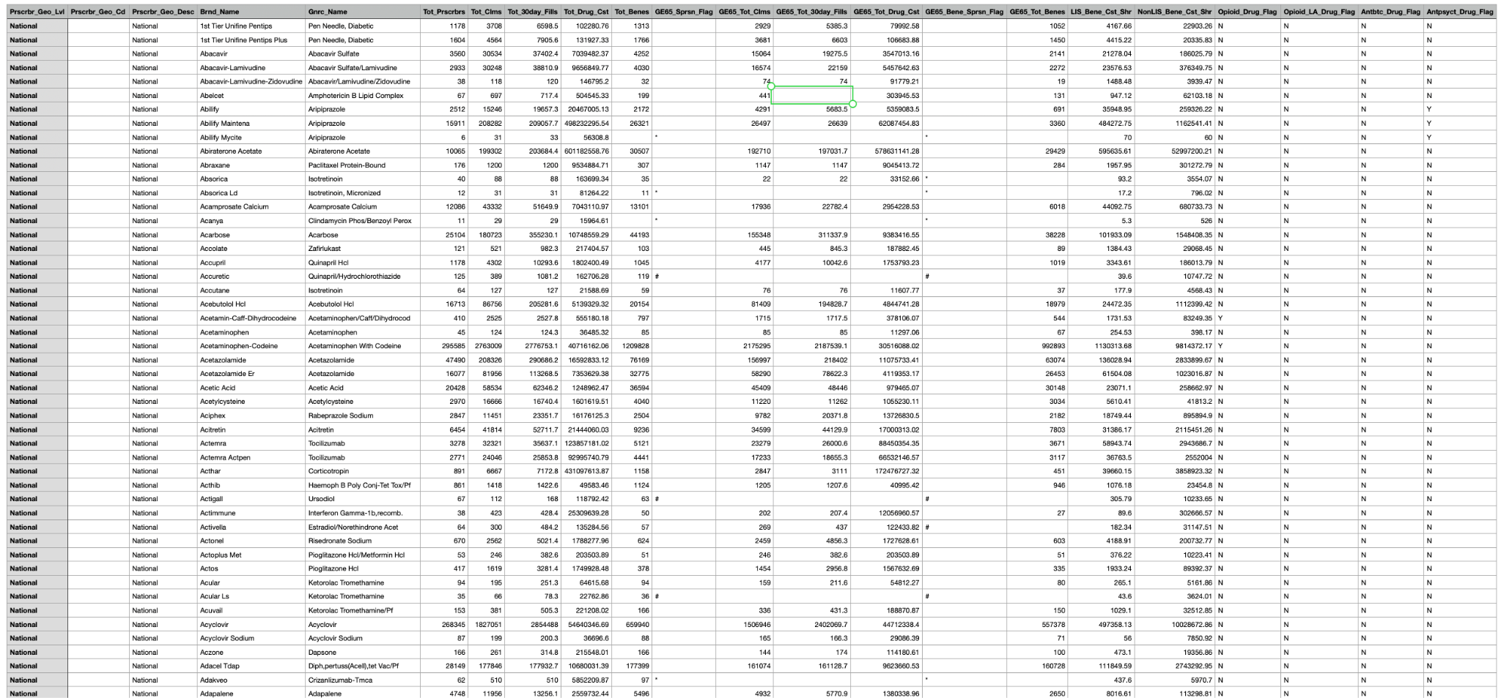
Dataset

Slide 9
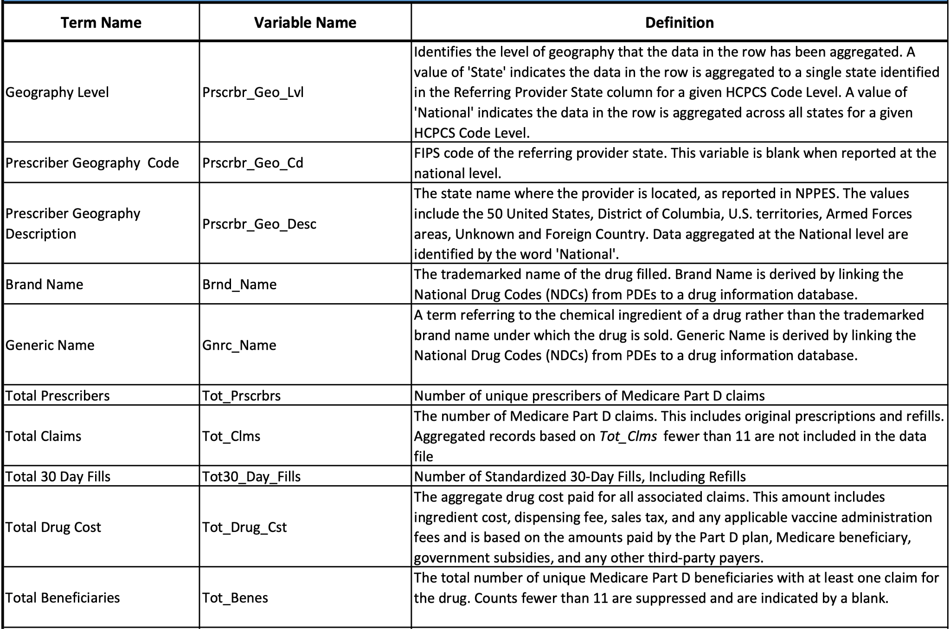
Medicare Part D Prescribers - by Geography and Drug Data Dictionary

Slide 10
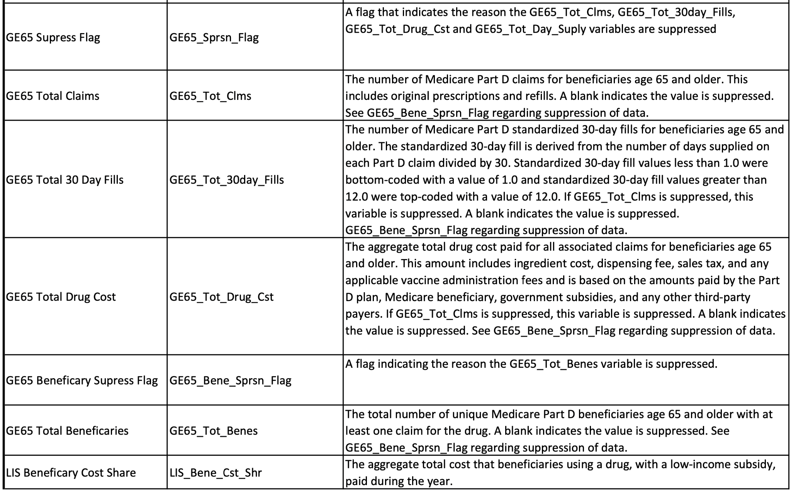

Slide 11
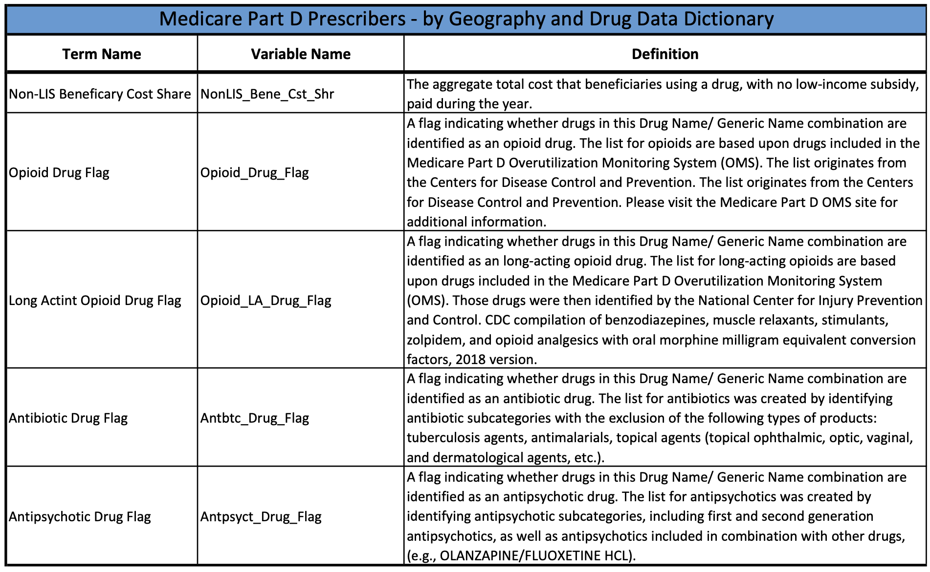

Slide 12
Features Used
Following the encoding process, three features are selected for the modeling phase:
The total number of claims :
Total number of claims represents how often a drug has been prescribed
Frequency can indicate the popularity or the necessity of a drug
In machine learning models, frequency data can help distinguish between drugs that are commonly used versus those used only in specific circumstances, potentially indicating different classes of drugs
Total drug costs:
Shows insights beyond just the economic figures—it can reflect the complexity of the drug’s production, its market demand, and its accessibility.
Expensive drugs might be specialized treatments or newer drugs with patent protection, while less expensive drugs could be generics widely used in various treatments.
Encoded generic names:
Specific drug name is a direct identifier of the drug and helps to establish correlations and patterns among different drugs and their classifications.

Slide 13
Ensemble Learning Models
Ensemble learning is a machine learning paradigm where multiple models (often called "weak learners") are trained to solve the same problem and combined to get better results. The fundamental premise is that a group of weak learners can together make more accurate predictions than any single model alone.
The main aim of using ensemble methods in diagnostic accuracy is to improve the robustness and accuracy of predictions, which is crucial in medical diagnosis due to the complexity of data and the high cost of errors.
Ensemble models are particularly effective in reducing variance and bias, avoiding overfitting, and enhancing the prediction performance across diverse datasets.

Slide 14
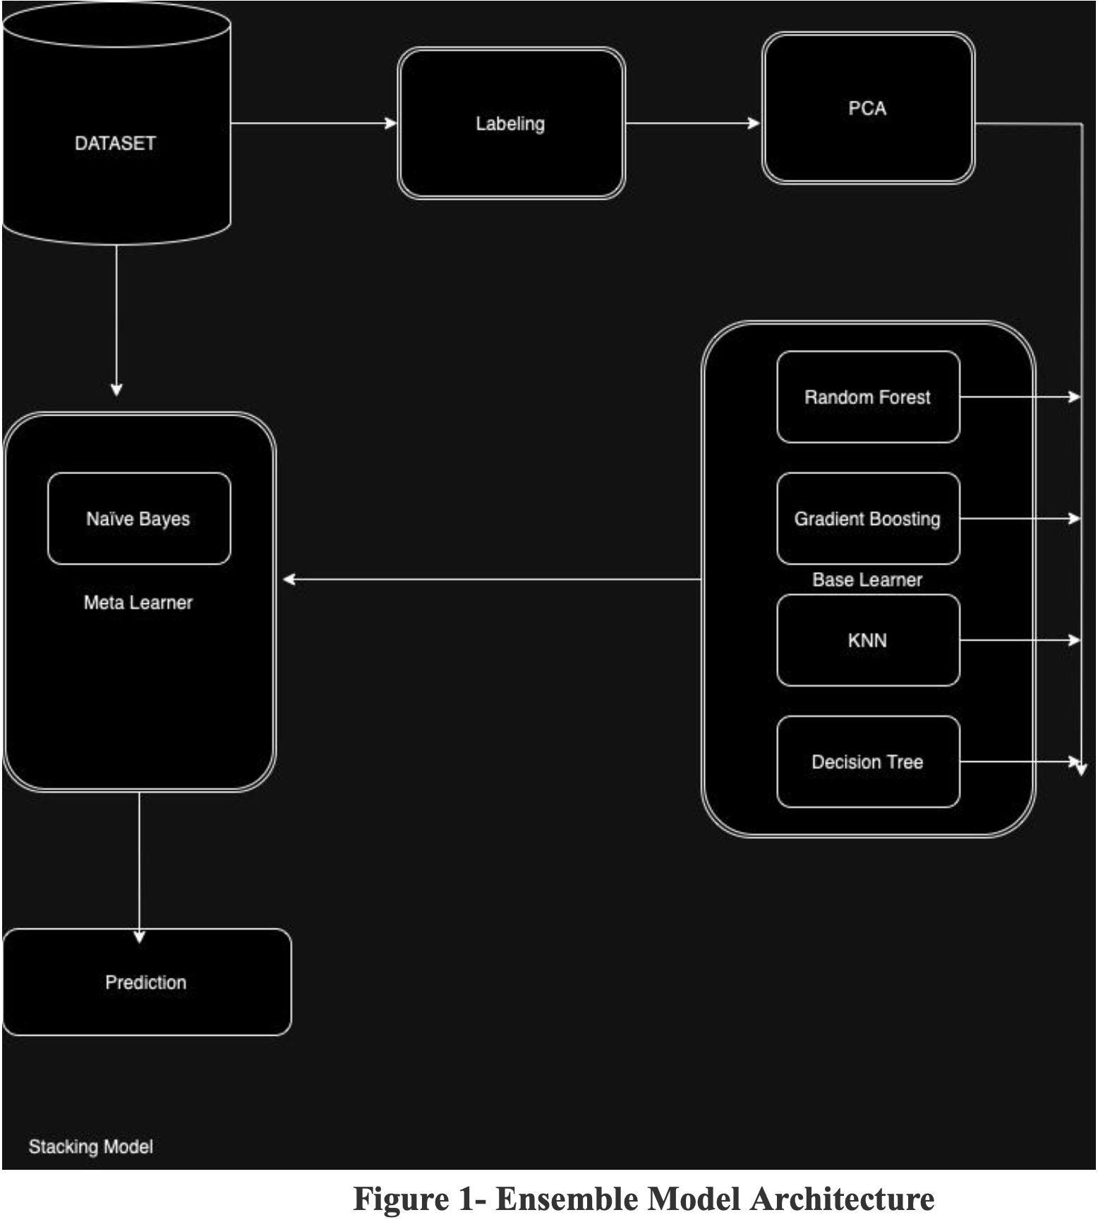
Stacking
To reduce the error rate, the approach of combining several machine learning techniques into a single predictive model is adopted, aiming to enhance predictive accuracy.
Predictions from each base model serve as inputs for a meta-level classifier, which then produces the final prediction.
All the base models are trained using the available data. Subsequently, a hybrid model that incorporates the strengths of these individual models is trained to make the final prediction, effectively leveraging the collective insight for more accurate outcomes.

Slide 15
Data Preprocessing
Reading a CSV file into a pandas DataFrame.
Transforming the categorical variable 'Gnrc_Name' into a numerical format. This encoding is necessary because most machine learning algorithms require input to be numeric.
Defining conditions based on various flags in the dataset indicating whether a drug falls into categories like opioids or antibiotics.
These flags are combined into a single target variable, `Drug_Classification`, which simplifies the task into a multiclass classification problem.
Principal Component Analysis (PCA) is applied to reduce the dimensionality of the features while attempting to preserve the variance (information) in the data.The feature space is reduced to two principal components, aiming to simplify the model while preserving essential information.41.29% of the variability
Is represented by first principal component 33.32% by second one.

Slide 16
Model Training and Evaluation
The primary challenge is to classify drugs into one of four categories: Opioid, Long-Acting Opioid (Opioid_LA), Antibiotic, and Antipsychotic, leveraging the given features.
Drug_Classification,target variable is subsequently encoded, providing a numerical representation of the drug categories to be predicted.Various classification models such as Random Forest, Gradient Boosting, K-Nearest Neighbors, and Decision Tree are initialized and trained.
Predictions from multiple base models are used as features for a meta-model, which in this case is a Gaussian Naive Bayes classifier.
Following the encoding process, three features are selected for the modeling phase: the total number of claims, total drug costs, and the encoded generic names. These features are believed to hold significant information that could influence the drug's classification.

Slide 17
To ensure that all features contribute equally to the model's decision-making process, they are standardized using `StandardScaler`.
Predictions from each base model serve as inputs for a meta-level classifier, which then produces the final prediction.
All the base models are trained using the available data. Subsequently, a hybrid model that incorporates the strengths of these individual models is trained to make the final prediction, effectively leveraging the collective insight for more accurate outcomes.
This ensemble approach, where the meta-model aims to improve the prediction performance by learning from the predictions of other models, represents a sophisticated data mining technique.
The models are evaluated using metrics like accuracy and Cohen's kappa score.

Slide 18
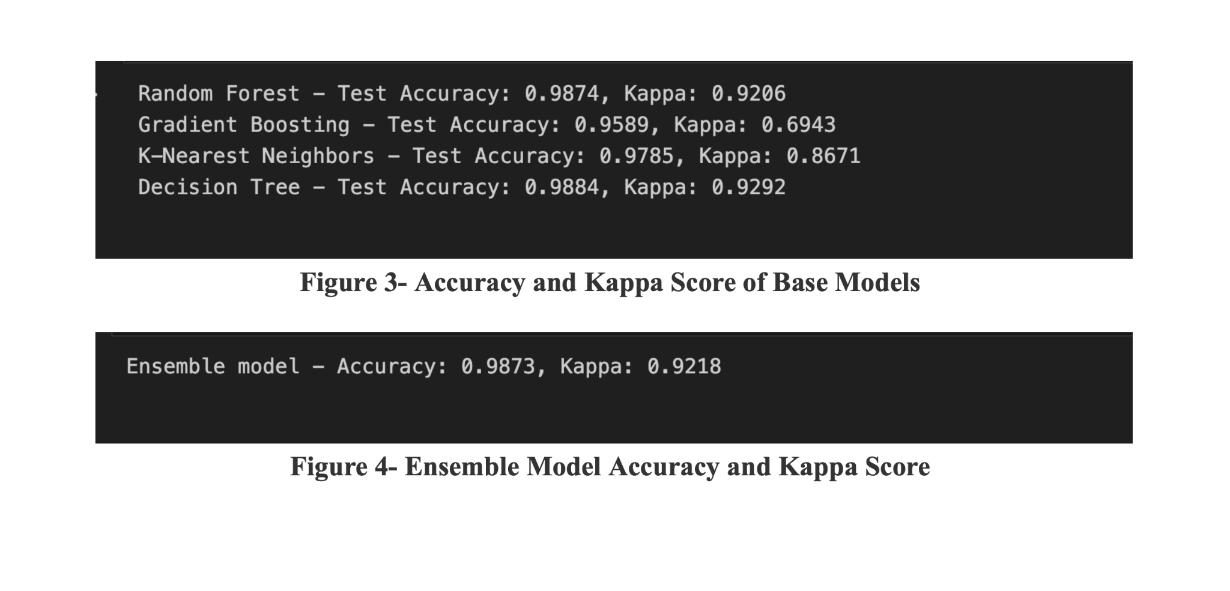
Results

Slide 19
Applications
Drug Utilization Research: By classifying drugs into categories for example, in this model as opioids, antibiotics, and antipsychotics, one can analyze patterns in drug utilization. This help in understanding the prescribing trends, identifying potential overuse or misuse of certain drug classes, and developing strategies for more effective and safer drug use.
Pharmacy Inventory Management: Pharmacies can use this model to optimize their inventory levels based on the classification of drugs. Understanding drug categories that are more in demand in specific locations can help in better stock management, ensuring the availability of essential medications while reducing the wastage of less frequently used drugs.
Pharmaceutical Marketing and Sales Strategy: Pharmaceutical companies can utilize insights from this model to tailor their marketing and sales strategies. By understanding the classifications of drugs that are most prescribed or have the highest demand, companies can focus their efforts on developing and promoting medications that meet the current needs of the healthcare sector.

Slide 20
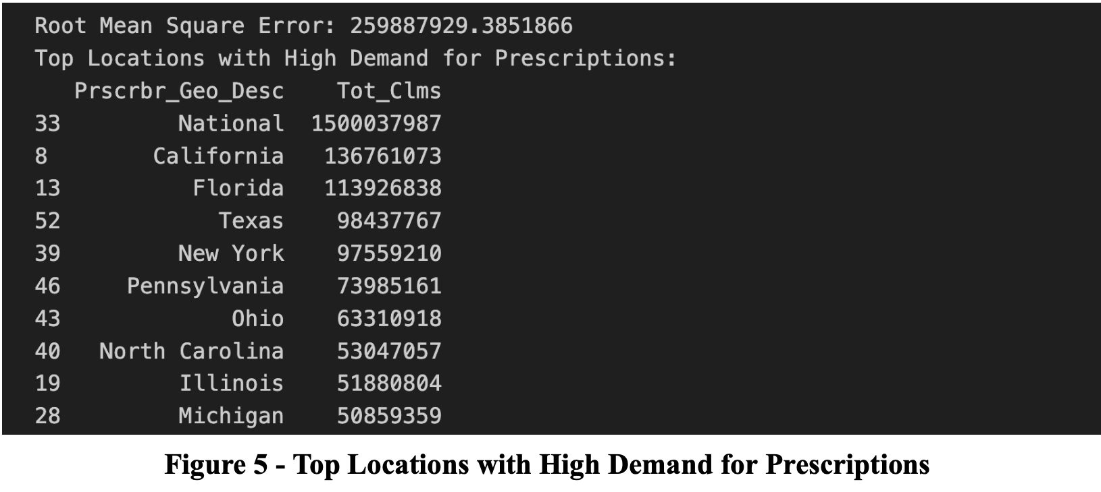
Pharmacy Inventory Management

Slide 21
Drug classification and diagnostic accuracy
Integration with Electronic Health Records (EHRs): Drug classification data can be integrated into EHRs and used by CDSS(Clinical Decision Support System) to provide real-time support to clinicians during the diagnostic process.
Personalized Medicine: Drug classification can also help in tailoring medication plans to individual patients' needs, considering factors like drug interactions, side effects, and effectiveness, thereby increasing the accuracy of treatment plans.
Identifying Misuse or Overuse: Understanding which drugs are overprescribed or misused can alert healthcare providers to potential diagnostic inaccuracies or the need for alternative treatments.
For instance,If a system knows which drug classes are effective for certain symptoms or conditions, it can recommend these drugs more reliably when similar symptoms are presented, thus supporting accurate diagnosis.
For instance, if a model recognizes that a particular drug is predominantly used for a specific cancer, frequent prescriptions of this drug could prompt early screening and diagnostic measures for at-risk patients.

Slide 22
Conclusion
The application of machine learning techniques, including preprocessing, dimensionality reduction, multiple classification algorithms, and ensemble modeling, makes this model serve several valuable purposes in healthcare and pharmaceutical sectors.
By effectively categorizing drugs into specific classes such as opioids, antibiotics, antipsychotics, and others, the project not only aids in understanding prescribing patterns and drug utilization but also serves as a foundational tool for a multitude of applications ranging from pharmacy inventory management to clinical decision support, and public health policy formulation.
Providing a scalable solution that can accommodate new data and evolving classification needs.This adaptability is essential in the rapidly changing landscape of healthcare and pharmaceuticals, where new drugs are continuously introduced, and prescribing guidelines are frequently updated.
The methodologies and insights derived from this work can serve as a foundation for further research and development in the field, encouraging the integration of machine learning tools into various aspects of healthcare and pharmaceutical management.

Slide 23


